Slide 1
Building a full stack data visualization web application
Using React, D3, & Firestore
Project by Patrick Dodd

Slide 2
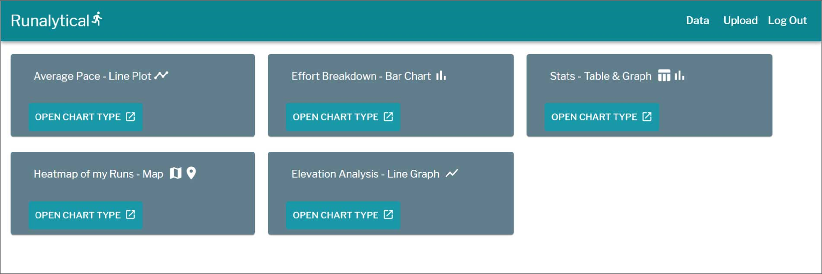
Project summary
Employing running data from the activity tracker Strava, I sought to create novel visualizations to act as a training enhancement for a Strava user.

Slide 3



Learning the stack
Started by learning each piece of technology that I needed (React, D3, Firebase)
Since I had not worked with them before, it took a bit longer to learn them than initially expected
Other challenges:
How to combine the stack
How to structure NoSQL
D3 is fairly low-level

Slide 4


FINDING THE RIGHT TOOLS
Began building/styling my UI by using Materialize CSS
Soon found it was often uncooperative with React
At a sponsor’s and my faculty advisor’s recommendation, I switched to Material-UI:
MUI is built to work with React
MUI is a well supported and stable library

Slide 5
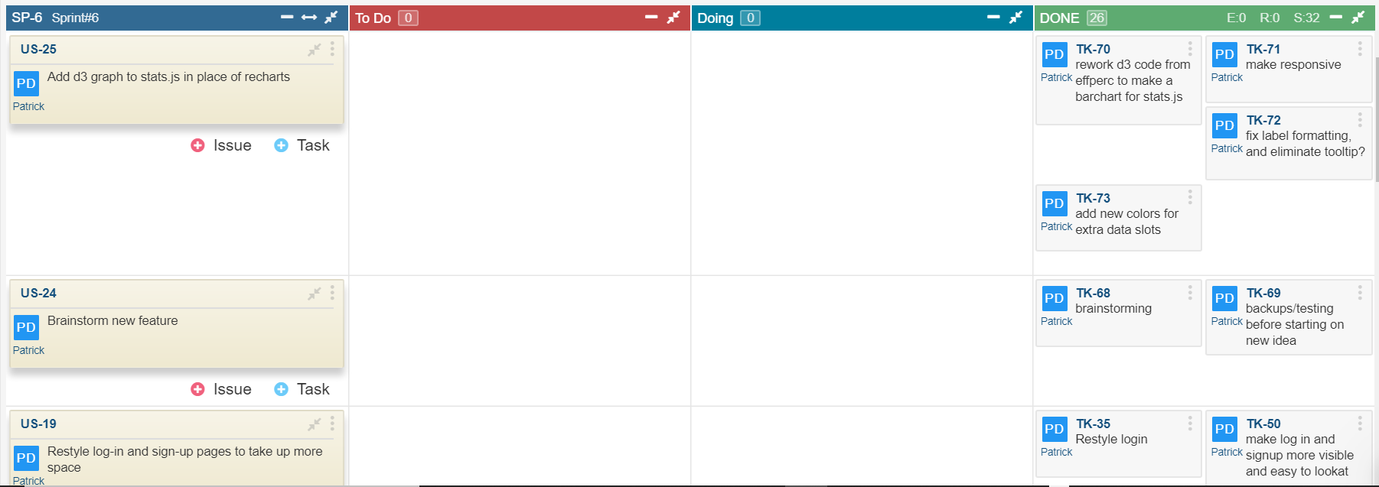
Agile Project management
Managed my progress using a Scrum board
User stories were broken into tasks and progress was tracked in weekly sprints

Slide 6
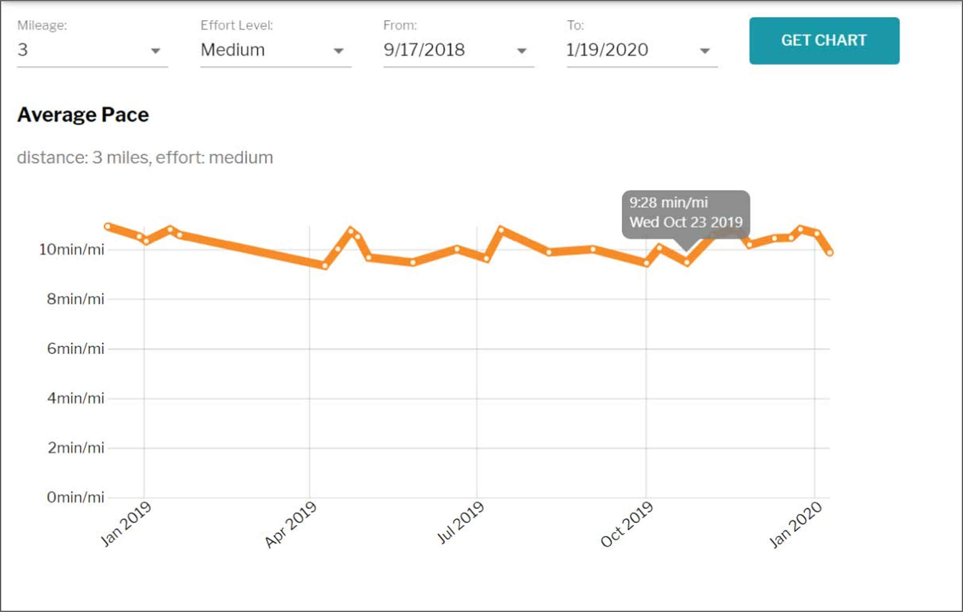
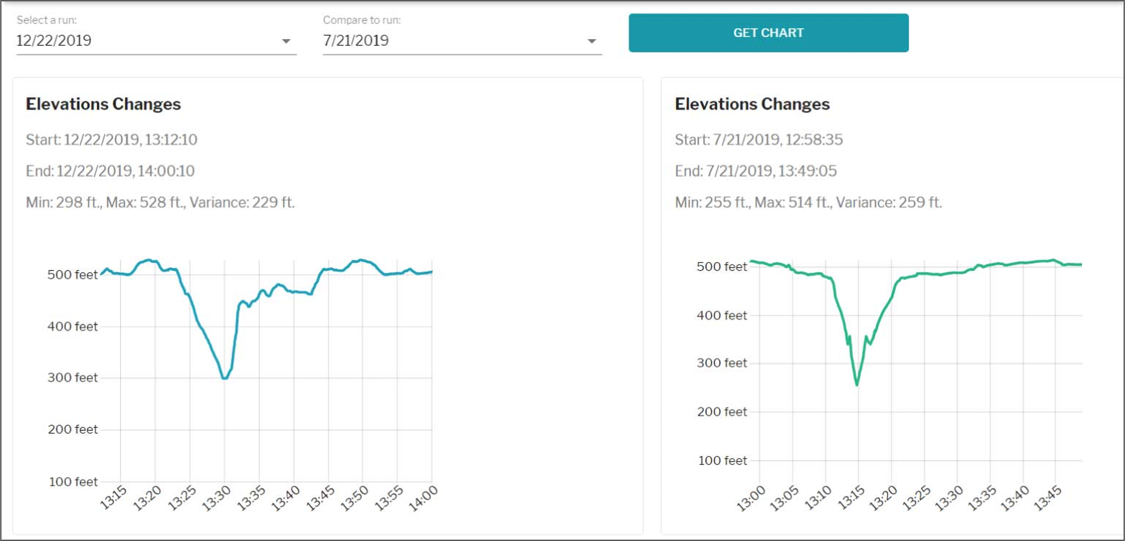
Visualizing data
Deciding what to build?
I had some initial features I wanted to build
Being able to filter similar runs by mileage, effort, and date range
Being able to compare elevation profiles

Slide 7
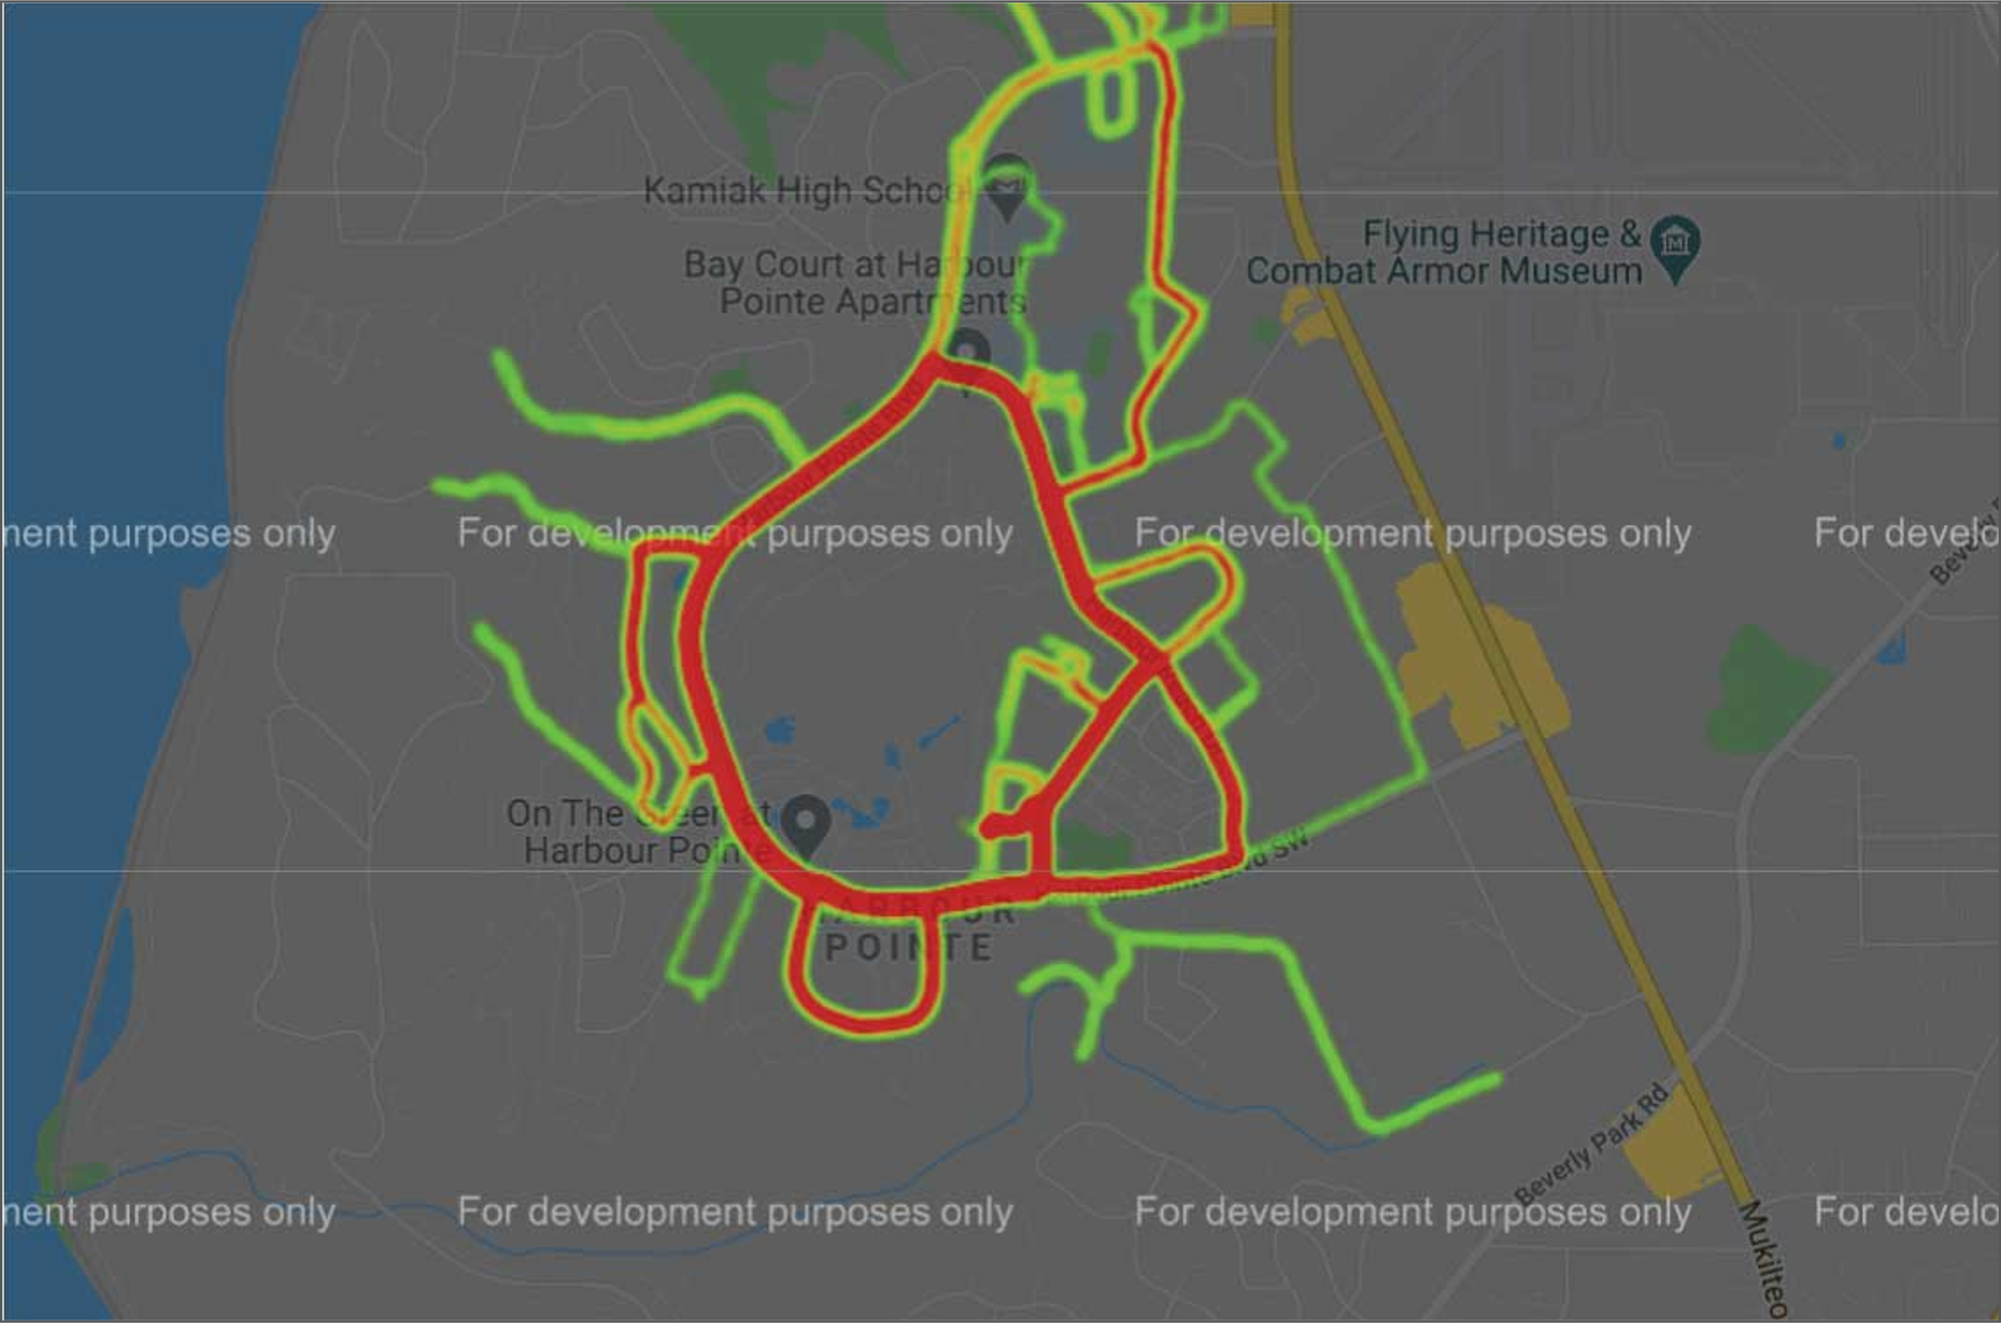
Creative visualization
Sometime ideas would occur from simply looking at data I wasn’t sure would be useful at first
In this instance, I used the Google Maps Javascript API to create a heatmap of all the gps data from my runs

Slide 8

Working with my sponsors
Sponsors:
Dr. Nicholas Runte Hughes, DPT and runner
Jack Lightfoot, Software Developer and runner
Able to bounce ideas off of fellow runners
Getting advice from subject matter experts
Getting technical tips on tools

Slide 9
Thanks for listening!
QUESTIONS OR COMMENTS?

Slide 10
